Slide 1


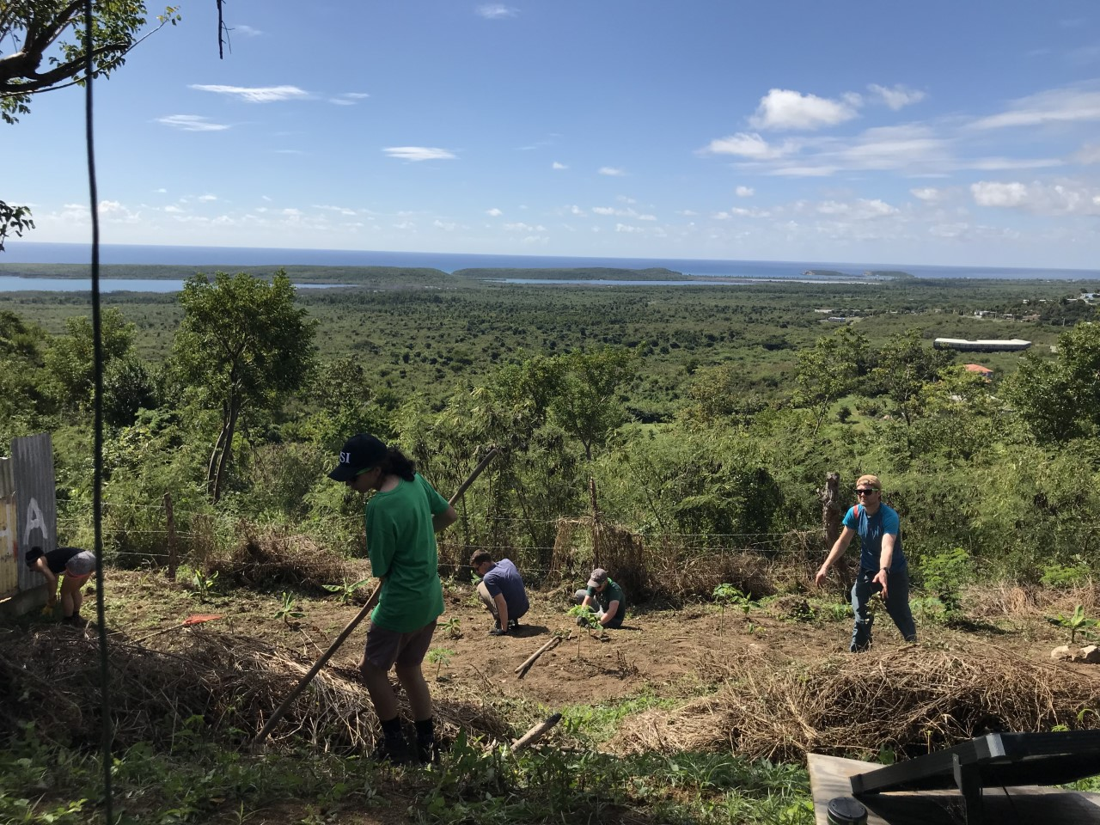
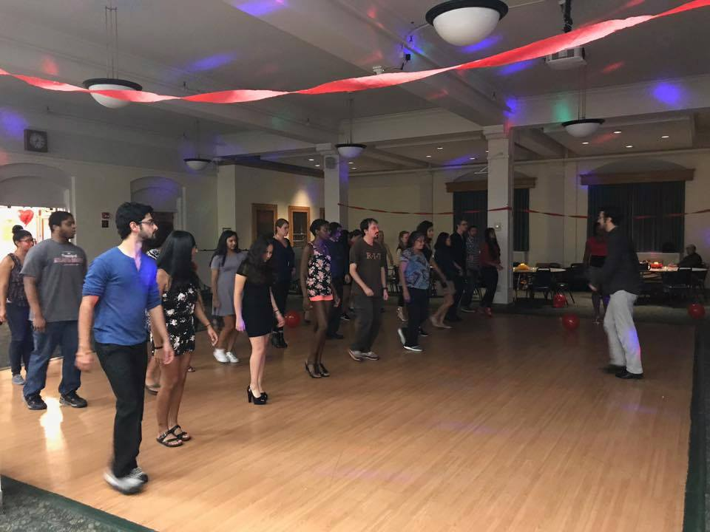
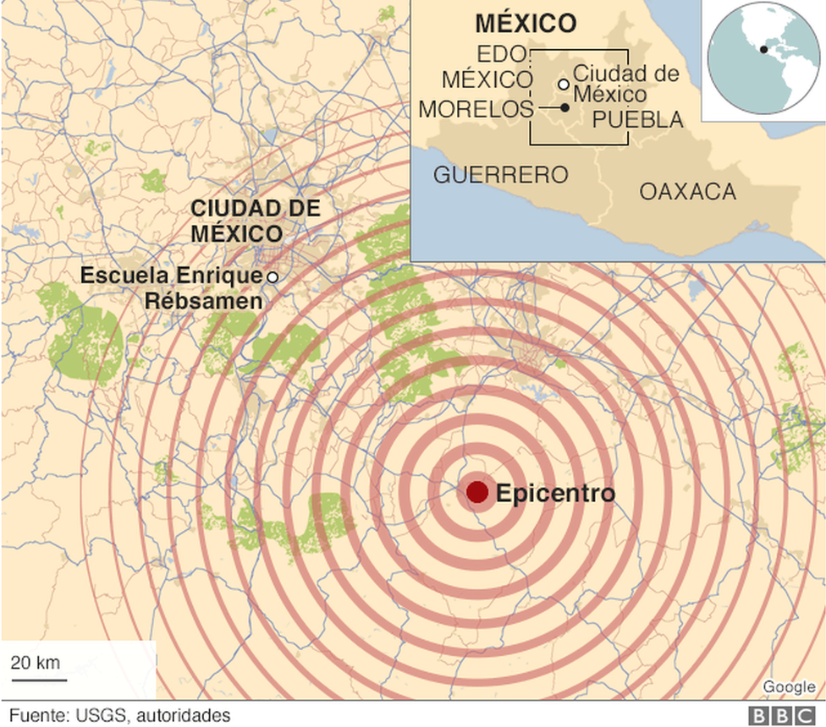
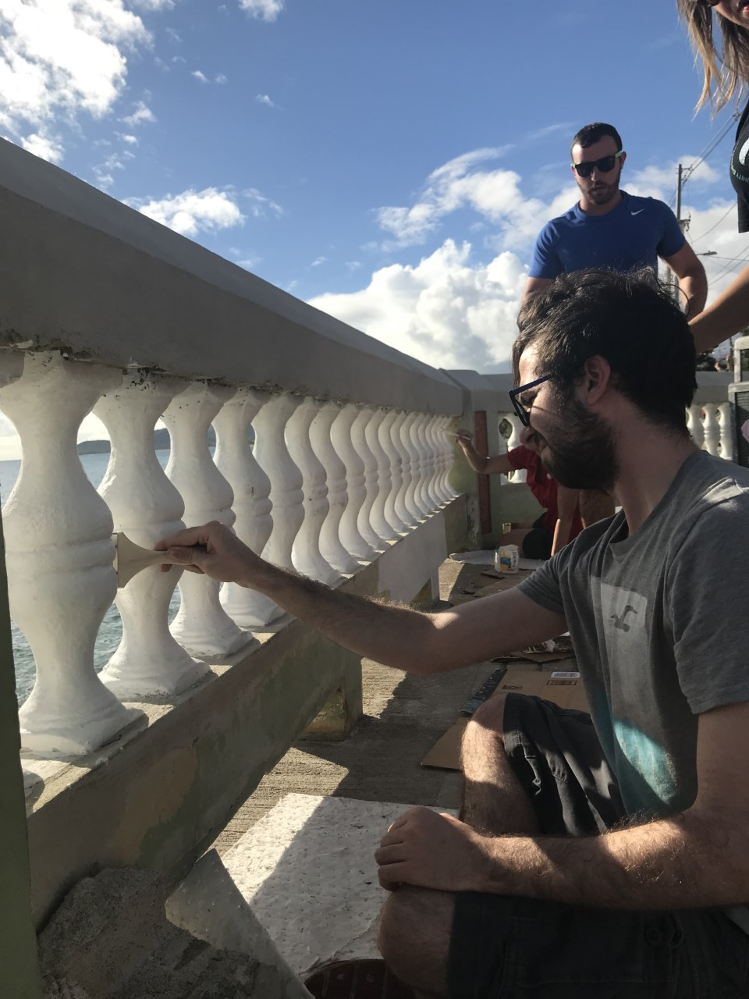
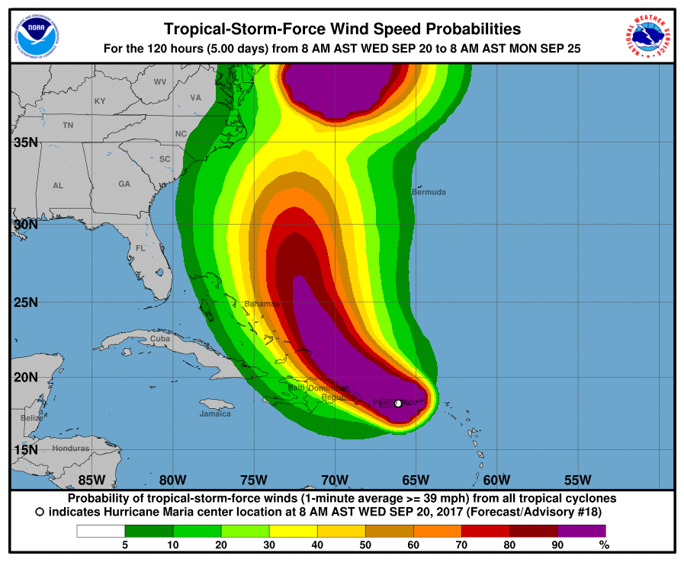
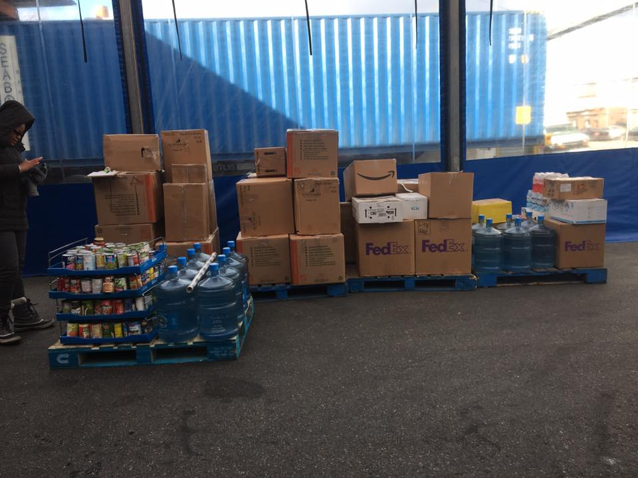
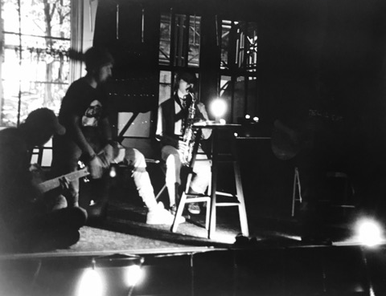
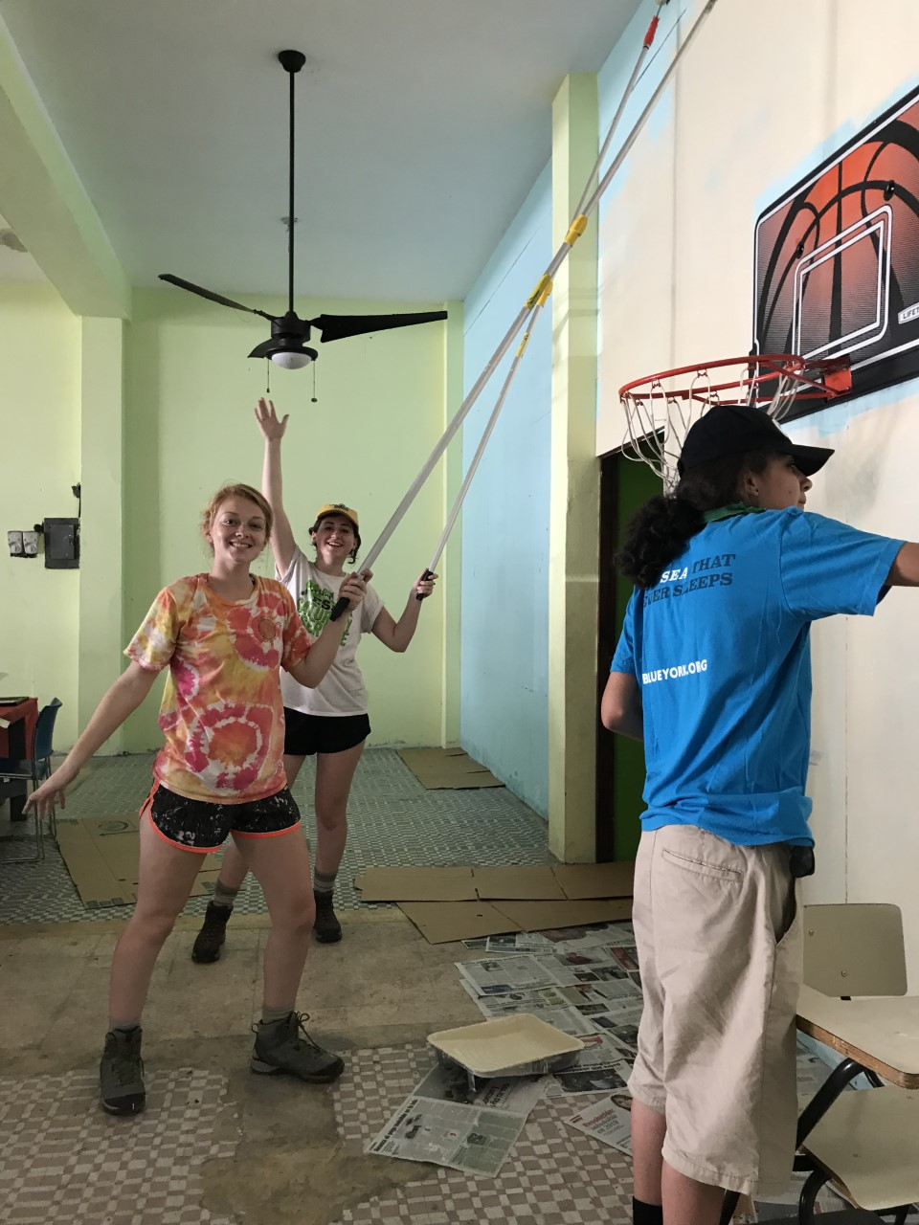
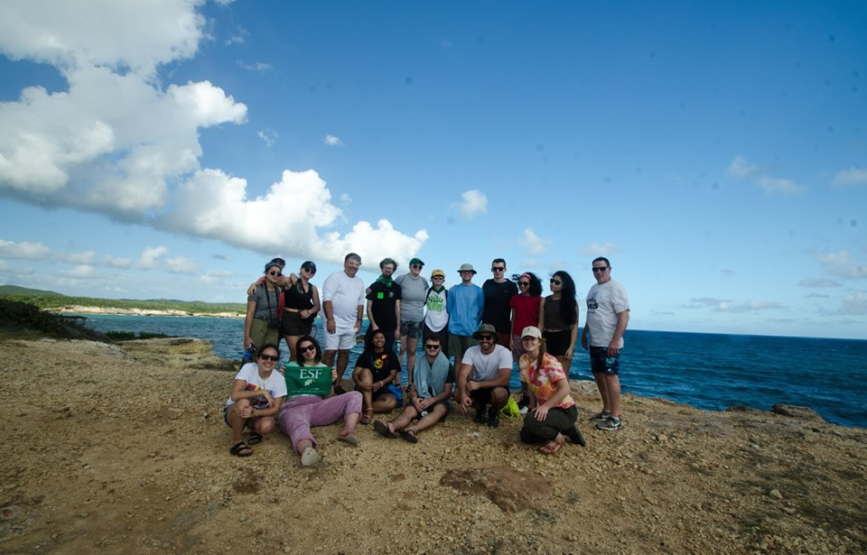
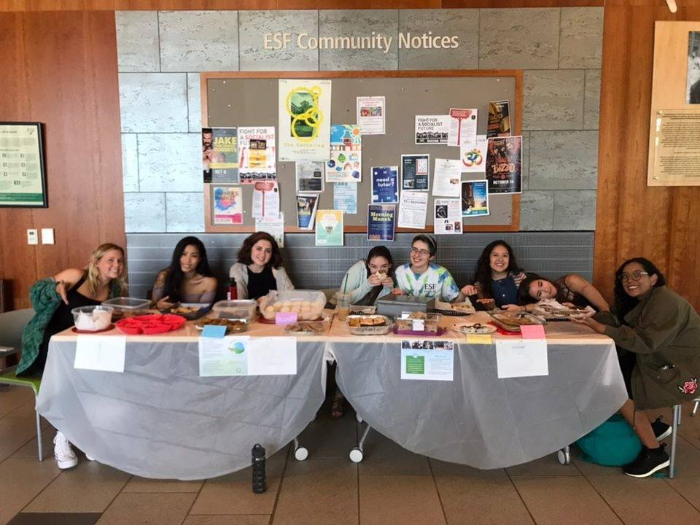
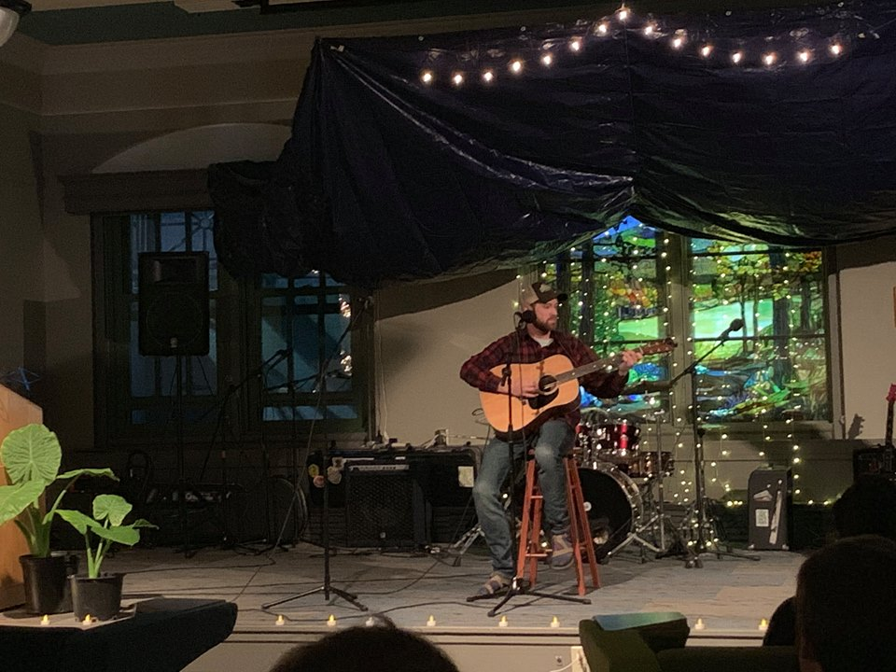
The Impacts of Acorns to Action in Communities Post Hurricane Maria
Paulina Casasola Mena, SUNY College of Environmental Science and Forestry
ACORNS TO ACTION
FUNDRAISING EVENTS
SERVICE TRIP AND EMPOWERMENT – VIEQUES PR
On September 21st 2017, students, staff and volunteers from the SUNY-ESF community gathered together to see what ESF could do to support communities impacted by natural disasters. The meeting happened days after many natural disasters took place in Mexico, Dominica, Puerto Rico, and US Virgin Islands.
Everyone in the room had the same question “What can we do to help?”
The answer was creating a group to help educate, raise funds and mobilize people while empowering members of impacted communities. That is how Acorns to Action, the ESF Disaster Relief Organization was born.
I attended this first meeting and co-founded Acorns to Action with the purpose of helping my family in Mexico, which was affected by the 19S earthquake, and the communities in the Caribbean, who were devastated after Maria.
Between 2017-2018 A2A raised over eight thousand dollars from bake sales, events, and donations from student organizations and staff members.
Some of the group’s highlight events include salsa night fundraisers in partnership with CNY Project Hope, Chipotle fundraisers, food and toiletries drives, zero electricity events, concerts for Puerto Rico, and activity fairs.
In January 2019 members of the organization went on a trip to Vieques, PR to support and learn from communities still recovering from Maria.
A group of 18 students and ESF staff members assisted local Viequenses in restoring schools and farms, cleaning parks, improving trails, and painting Vieques Malecon.
The Salsa Night Fundraiser on 0ctober 7th 2017 helped raise almost eight hundred dollars for Cruz Roja Mexicana, Virgin Islands Relief Fund, ComPRometidos, and other organizations that directly benefitted impacted countries.
ESF students and faculty attended the event and helped coordinate it.
Volunteers working in Ana’s farm
We collaborated with local researchers, farmers, and organizations such as Vieques Love and Vieques Trust. The leaders of the town showed us how we could help support the island after the hurricane and we worked towards meeting their needs. Painting the Malecon (one of the main streets in the island) was one of the most meaningful experiences because of the beautiful view and the historical importance of it.
Salsa Night Fundraiser
Source: Acorns to Action Facebook page 2017
From November 17 to December 10th 2017, Acorns to Action hosted a donation drive in partnership with Syracuse University to donate food items and medical supplies. Donations were sent to the New Day Fellowship and Deliverance Ministries in Dominica.
Hurricane Maria Wind Speed
Source: NOAA 2017
19S Earthquake Epicenter
Source: USGS
Acorns to Action (A2A) is an ESF student and administration run organization. Our primary goal is to connect our organization to the affected country or state and help them recover in a way that is culturally respectful as well as sensitive to their needs. We provide the resources, funds, and volunteers communities request while exchanging the knowledge required to achieve sustainable and socially responsible goals.
Matt Wynne painting the Malecon
Donations for Dominica
Source: Isabella Kaplan 2018
Not only did our group had the opportunity to help and provide support, but we also learned about personal experiences that people had before, during, and after Maria.
We were inspired by their strength and power of such a special community that held itself together during such a difficult time.
During our service trip we learned the environmental justice issues that have been affecting Vieques for a long time and how climate change will impact islands like Puerto Rico.
“Blackout: Empower Puerto Rico” was the first concert in a series of events where ESF students performed and spoke about environmental justice. It was held on March 24th 2018 and it was a zero-electricity concert with the purpose of creating awareness about the lack of services in Puerto Rico.
The second concert “Blue Tarp Party” had the purpose of educating the public about the amount of people in PR without roofs in 2019
Acorns to Action Volunteers in PR
Source: Acorns to Action Facebook page 2019
Bake sale at SUNY ESF
Source: Acorns to Action Facebook page 2018
Devon, Mallory and Emily painting the school
Since 2017 ESF volunteers and Acorns to Action members have fundraised for and supported people affected by hurricanes, storms, wildfires, and earthquakes in the Caribbean, the Carolinas, Texas, Mexico, Florida, California, and Indonesia.
Since the service trip A2A has been committed to continue supporting Vieques and other places in Puerto Rico. The connection we have with the island is special and we want to keep supporting them and learning from them.
Blackout Empower PR and Blue Tarp Party
Source: Acorns to Action Facebook page
I would like to thank the ESF faculty, staff, and students who have made these relief efforts possible. I would also like to acknowledge the work of the current A2A members and disaster relief organizations – you are changing the world.
Notes:
Cbs news 2018 malecon
Mexico bbc 2017

